Slide 1

Slingspy Group 11
Sam McMillan, Peter Vaughn, Charles Gillard, Alexandru Slav

Slide 2
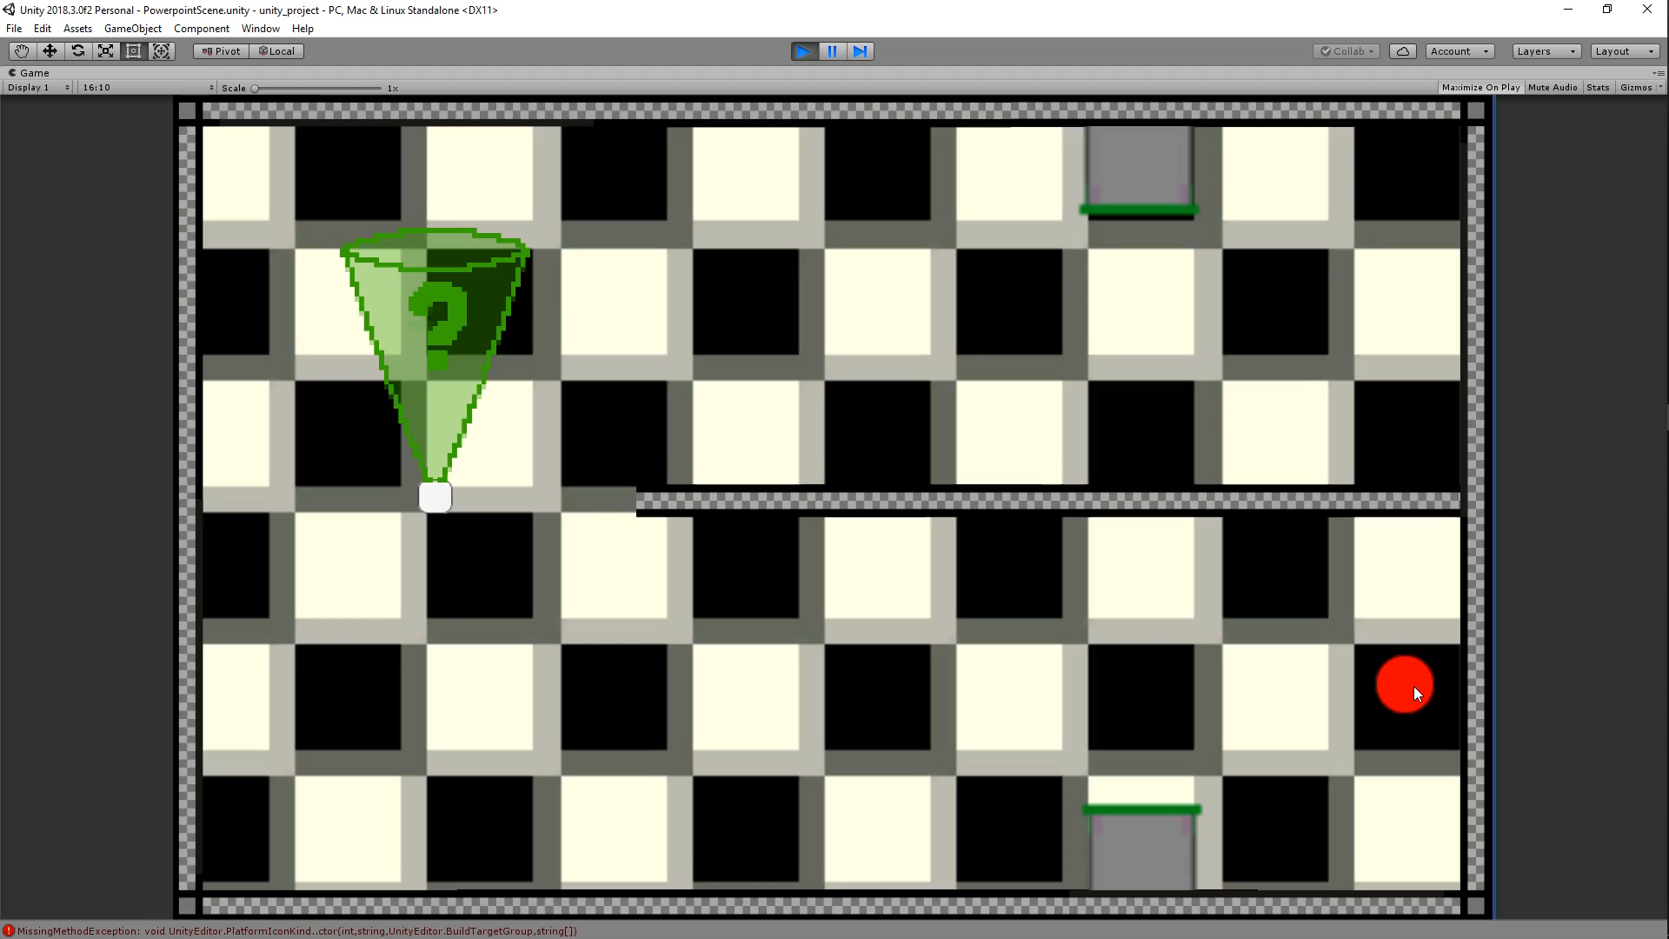
Playthrough Video

Slide 3


Mechanics
Sumo Digital Brief – Change core mechanic
Alter how the game is played
Slingspy is a Stealth Golf game
Removed WASD controls
Replaced with a putting mechanic

Slide 4


Why Putt?
Stealth games often forgive mistakes
Putt movement forces players to commit to movement
No time constraints
Study enemy patrols, plan route

Slide 5





Our Final Deliverables
3 Zones
Filled with 5 levels each
5 Mechanics

Slide 6
Questions?

